Slide 1

XSL Transformations
(XSLT)
Meghasyam Bokam
April’1st, 2002

Slide 2
Background
XSL (Extensible Stylesheet Language) : is a language for expressing style sheets. It consists of two parts:
  a language for transforming XML documents - XSLT
  an XML vocabulary for specifying formatting semantics - XSLFO
XSL specifies the styling of an XML document by using XSLT to describe how the document is transformed into another XML document that uses the formatting vocabulary.

Slide 3
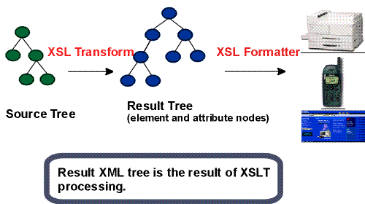

Slide 4
What is XSLT?
  is a language for transforming XML documents into other XML documents.
  is designed for use as part of XSL
  describes rules for transforming a source tree into a result tree.
  uses the expression language defined by XPath
  for selecting nodes.
  is designed primarily for XML-to-XML and XML-to-HTML transformations.

Slide 5
Data Model
The data model used by XSLT is the same as that used by Xpath.
The tree structure of XML document consists of 7 nodes:
      The root node
      Element nodes
      Text nodes
      Attribute nodes
      Namespace nodes
      Processing Instruction nodes
      Comment nodes
XSLT operates on source, result and stylesheet documents using the same data model.
Notes:
Here I need to add two slides from Xpath presentation

Slide 6
How Tree Transformation Works?
a transformation expressed in XSLT is called a style sheet.
this style sheet describes rules for transforming a source tree into a result tree.
an XSLT processor reads both an XML document and an XSLT style sheet, and it outputs a new XML document or fragment.
the transformation is achieved by associating patterns with templates.
a pattern is matched against elements in the source tree.
a template is instantiated to create part of the result tree.

Slide 7
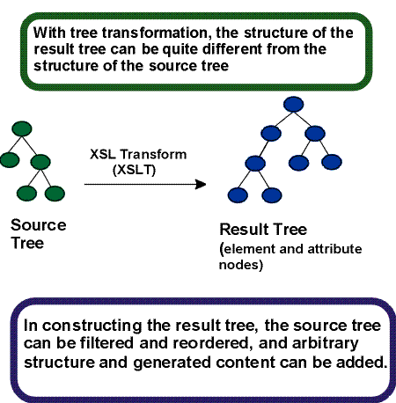

Slide 8
Example: Periodic Table with two Atoms
<?xml version="1.0"?>
<?xml-stylesheet type="text/xml" href=“eg.xsl"?>
<PERIODIC_TABLE>
<ATOM STATE="GAS">
<NAME>Hydrogen</NAME>
<SYMBOL>H</SYMBOL>
<ATOMIC_NUMBER>1</ATOMIC_NUMBER> <ATOMIC_WEIGHT>1.00794</ATOMIC_WEIGHT>
<BOILING_POINT UNITS="Kelvin">20.28</BOILING_POINT>
<MELTING_POINT UNITS="Kelvin">13.81</MELTING_POINT>
<DENSITY UNITS="grams/cubic centimeter">
<!-- At 300K, 1 atm -->
0.0000899
</DENSITY>
</ATOM>
<ATOM STATE="GAS">
<NAME>Helium</NAME>
<SYMBOL>He</SYMBOL>
<ATOMIC_NUMBER>2</ATOMIC_NUMBER> <ATOMIC_WEIGHT>4.0026</ATOMIC_WEIGHT>
<BOILING_POINT UNITS="Kelvin">4.216</BOILING_POINT>
<MELTING_POINT UNITS="Kelvin">0.95</MELTING_POINT>
<DENSITY UNITS="grams/cubic centimeter">
<!-- At 300K -->
0.0001785
</DENSITY>
</ATOM>
</PERIODIC_TABLE>

Slide 9
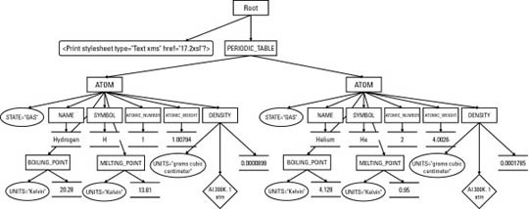
Tree Representation of Periodic Table

Slide 10
XSL Templates
Template rules identify the nodes to which they apply by using a pattern.
A template rule is specified with the xsl:template element.
The content of the xsl:template element is the actual template to be instantiated
The match attribute is a Pattern that identifies the source node or nodes to which the rule applies.
<xsl:template match = pattern >
The syntax for patterns is a subset of the syntax for Xpath expressions.

Slide 11
The xsl:apply-templates element
xsl:apply-templates in the output template, tells the formatter to compare each child element of the matched source element against the templates in the style sheet, and, if a match is found, output the template for the matched node.
The template for the matched node may itself contain xsl:apply-templates elements to search for matches for its children.

Slide 12
An XSLT style sheet (eg.xsl) for the periodic table with two template rules
<?xml version="1.0"?>
<xsl:stylesheet version="1.0"
xmlns:xsl ="http://www.w3.org/1999/XSL/Transform">
<xsl:template match="/">
<html>
<xsl:apply-templates/>
</html>
</xsl:template>
<xsl:template match="PERIODIC_TABLE">
<body>
<xsl:apply-templates/>
</body>
</xsl:template>
<xsl:template match="ATOM">
An Atom
</xsl:template>
</xsl:stylesheet>
The result is:
<html>
<body>
An Atom
An Atom
</body>
</html>

Slide 13
The select attribute
<xsl:template match="ATOM">
<xsl:apply-templates select="NAME"/>
</xsl:template>
The result is:
<html>
<body>
Hydrogen
Helium
</body>
</html>

Slide 14
Computing the value of a Node with xsl:value-of
<xsl:template match="ATOM">
<xsl:value-of select="NAME"/>
</xsl:template>
The result is:
<html>
<body>
Hydrogen
Helium
</body>
</html>

Slide 15
Values of Nodes in xsl:value-of
Node Type:
Value:
Root
The value of the root element
Element
The concatenation of all parsed character data contained in the element, including character data in any of the descendants of the element
Text
The text of the node; essentially the node itself
Attribute
The attribute value after entities are resolved and leading and trailing white space is stripped; does not include the name of the attribute, the equals sign, or the quotation marks
Namespace
The URI of the namespace
Processing instruction
The data in the processing instruction; does not include the processing instruction , <? or ?>
Comment
The text of the comment, <!-- and --> not included

Slide 16
Processing Multiple Elements with xsl:for-each
<xsl:template match="PERIODIC_TABLE">
<xsl:for-each select="ATOM">
<xsl:value-of select="."/>
</xsl:for-each>
</xsl:template>
The select="." in this template tells the formatter to take the value of the matched element, ATOM in this example.

Slide 17
Patterns for Matching Nodes
The match attribute of the xsl:template element supports a complex syntax that allows you to express exactly which nodes you do and do not want to match
Matching the root node
To specify the root node in a rule, you give its match attribute the value "/".
Eg. <xsl:template match="/">

Slide 18
Matching element names
Eg. <xsl:template match="ATOM">
Matching children with /
The / symbol is used to match specified hierarchies of elements.
Eg. 1. <xsl:template match="ATOM/SYMBOL">
Eg. 2. <xsl:template match="PERIODIC_TABLE/*/SYMBOL">
Notes:
‘*’ rep all elements which are children of periodic table

Slide 19
Matching descendants with //
The double slash, //, refers to a descendant element at an arbitrary level
Eg. 1. <xsl:template match="PERIODIC_TABLE//NAME">
Eg. 2. <xsl:template match="//ATOMIC_NUMBER">
Matching by ID
This is used to apply a particular style to a particular single element without changing all other elements of that type. This is done with the id() selector, which contains the ID value in single quotes.
Eg. <xsl:template match="id('e47')">
<b><xsl:value-of select="."/></b>
</xsl:template>
Notes:
Id- assumes that the element you select has an attr id in its dtd.

Slide 20
Matching attributes with @
The @ sign matches against attributes and selects nodes according to attribute names.
Ex:
<xsl:template match="MELTING_POINT">
<xsl:apply-templates select="@UNITS"/>
</xsl:template>
<xsl:template match="@UNITS">
<I><xsl:value-of select="."/></I>
</xsl:template>
The output is:
<I>kelvin</I>
<I>kelvin</I>

Slide 21
Using the or operator |
The vertical bar (| )allows a template rule to match multiple patterns.
Ex: <xsl:template match="ATOMIC_NUMBER|ATOMIC_WEIGHT">
Testing with [ ]
You can test for more details about the nodes that match a pattern using []. You can perform many different tests including:
  Whether an element contains a given child, attribute, or other node
  Whether the value of an attribute is a certain string
  Whether the value of an element matches a string
  What position a given node occupies in the hierarchy
Ex: 1. <xsl:template match="ATOM[MELTING_POINT]">
Ex: 2. <xsl:template match="ATOM[DENSITY/@UNITS]">
Ex: 3. <xsl:template match="ATOM[ATOMIC_NUMBER='10']">

Slide 22
The Default Template Rules
The default rule for elements:
This default rule applies to element nodes and the root node:
<xsl:template match="*|/">
<xsl:apply-templates/>
</xsl:template>
*|/ is XPath shorthand for "any element node or the root node."
The purpose of this rule is to ensure that all elements are recursively processed even if they aren't reached by following the explicit rules.

Slide 23
The default rule for text nodes and attributes:
This rule is:
<xsl:template match="text()|@*">
<xsl:value-of select="."/>
</xsl:template>
This rule matches all text and attribute nodes (match="text()|@*") and outputs the value of the node (<xsl:value-of select="."/>).
This rule ensures that at the very least an element's text is output, even if no rule specifically matches it.
This rule also copies attribute values (but not names).
The default rule for processing instructions and comments:
It simply says to do nothing; that is, drop the processing instructions and comments from the output as if they didn't exist. It looks like this:
<xsl:template match="processing-instruction()|comment()"/>

Slide 24
Attribute value templates
Attribute value templates copy data from the input document to attribute values in the output.
Inside attribute values, data enclosed in curly braces {} takes the place of the xsl:value-of element.
Ex: To convert the periodic table into empty ATOM elements, the template can be written as:
<xsl:template match="ATOM">
<ATOM NAME="{NAME}“
ATOMIC_WEIGHT="{ATOMIC_WEIGHT}" ATOMIC_NUMBER="{ATOMIC_NUMBER}" />
</xsl:template>

Slide 25
The output is of the form:
<ATOM NAME="Vanadium"
ATOMIC_WEIGHT="50.9415"
ATOMIC_NUMBER="23" />
Ex 2:
<xsl:template match="ATOM">
<A HREF="{SYMBOL}.html">
<xsl:value-of select="NAME"/>
</A>
</xsl:template>
The output is of the form:
<A HREF=H.html>Hydrogen</A>
<A HREF=He.html>Helium</A>

Slide 26
Inserting elements into the output with xsl:element
The name of the element is given by an attribute value template in the name attribute of xsl:element.
The content of the element derives from the content of the xsl:element element, which may include xsl:attribute, xsl:processing-instruction, and xsl:comment instructions to insert these items.
Ex: To replace the ATOM elements with GAS, LIQUID, and SOLID elements
<xsl:template match="ATOM">
<xsl:element name="{@STATE}">
<NAME><xsl:value-of select="NAME"/></NAME>
<!-- rules for other children -->
</xsl:element>
</xsl:template>
Notes:
Depends on the “state” attribute

Slide 27
Inserting attributes into the output with xsl:attribute
The name of the attribute is specified by the name attribute of the xsl:attribute element.
The value of the attribute is given by the contents of the xsl:attribute element.
Each xsl:attribute element is a child of either an xsl:element element or a literal element.
Ex:
<xsl:template match="ATOM">
<LI><A>
<xsl:attribute name="HREF">
<xsl:value-of select="SYMBOL"/>.html
</xsl:attribute> <xsl:value-of select="NAME"/>
</A></LI>
</xsl:template>
The output is of the form:
<LI><A HREF="H.html">Hydrogen</A></LI>
<LI><A HREF="He.html">Helium</A></LI>

Slide 28
Generating processing instructions with xsl:processing-instruction
The target of the processing instruction is specified by a required name attribute
The contents of the xsl:processing-instruction element become the contents of the processing instruction.
Ex: This rule replaces PROGRAM elements with a gcc processing instruction:
<xsl:template match="PROGRAM">
<xsl:processing-instruction name="gcc"> -O4
</xsl:processing-instruction>
</xsl:template>
Output:
<?gcc -O4 ?>

Slide 29
Generating comments with xsl:comment
The xsl:comment element inserts a comment in the output document.
It has no attributes.
Its contents are the text of the comment.
Ex:
<xsl:template match="ATOM">
<xsl:comment>There was an atom here once.</xsl:comment> </xsl:template>
Output: This rule replaces ATOM nodes with this comment:
<!--There was an atom here once.-->

Slide 30
Generating text with xsl:text
The xsl:text element inserts its contents into the output document as literal text
Ex:
<xsl:template match="ATOM">
<xsl:text>There was an atom here once.</xsl:text> </xsl:template>
Output: This rule replaces each ATOM element with the string:
There was an atom here once.

Slide 31
Copying the Context Node with xsl:copy
The xsl:copy element copies the source node into the output tree.
Child elements, attributes, and other content are not automatically copied.
Ex: An XSLT style sheet that strips comments from a document
<?xml version="1.0"?>
<xsl:stylesheet version=“1.0” xmlns:xsl="http://www.w3.org/1999/XSL/Transform"> <xsl:template match="*|@*|processing-instruction()|text()">
<xsl:copy>
<xsl:apply-templates select="*|@*|processing-instruction()|text()"/> <xsl:copy>
</xsl:template>
</xsl:stylesheet>

Slide 32
Sorting Output Elements
The xsl:sort element sorts the output elements into a different order than they appear in the input.
An xsl:sort element appears as a child of an xsl:apply-templates element or xsl:for-each element.
The select attribute of the xsl:sort element defines the key used to sort the element's output by xsl:apply-templates or xsl:for-each

Slide 33
Ex: An XSLT style sheet that sorts by atomic number
<?xml version="1.0"?>
<xsl:stylesheet version="1.0" xmlns:xsl="http://www.w3.org/1999/XSL/Transform">
<xsl:template match="PERIODIC_TABLE">
<html>
<head>
<title>Atomic Number vs. Atomic Weight</title>
</head>
<body>
<h1>Atomic Number vs. Atomic Weight</h1>
<table>
<th>Element</th>
<th>Atomic Number</th>
<th>Atomic Weight</th>
<xsl:apply-templates>
<xsl:sort data-type=“number” select="ATOMIC_NUMBER"/>
</xsl:apply-templates>
</table>
</body>
</html>
</xsl:template>
<xsl:template match="ATOM">
<tr>
<td><xsl:apply-templates select="NAME"/></td> <td><xsl:apply-templates select="ATOMIC_NUMBER"/></td>
<td><xsl:apply-templates select="ATOMIC_WEIGHT"/></td>
</tr>
</xsl:template>
</xsl:stylesheet>

Slide 34
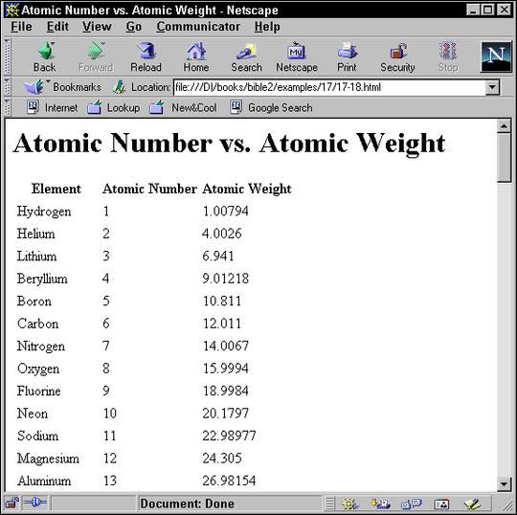
Output: Atoms numerically sorted by atomic number

Slide 35
Modes
Modes allow an element to be processed multiple times, each time producing a different result.
Both xsl:template and xsl:apply-templates have an optional mode attribute
Notes:
If xsl:template does not have a match attribute, it must not have a mode attribute. If an xsl:apply-templates element has a mode attribute, then it applies only to those template rules from xsl:template elements that have a mode attribute with the same value; if an xsl:apply-templates element does not have a mode attribute, then it applies only to those template rules from xsl:template elements that do not have a mode attribute.

Slide 36
Ex: An XSLT style sheet that uses modes to format the same data differently in two different places
<?xml version="1.0"?>
<xsl:stylesheet version="1.0" xmlns:xsl="http://www.w3.org/1999/XSL/Transform">
<xsl:template match="/PERIODIC_TABLE">
<HTML>
<HEAD>
<TITLE>The Elements</TITLE>
</HEAD>
<BODY>
<H2>Table of Contents</H2>
<UL>
<xsl:apply-templates select="ATOM" mode="toc"/>
</UL>
<H2>The Elements</H2>
<xsl:apply-templates select="ATOM" mode="full"/>
</BODY>
</HTML>
</xsl:template>
<xsl:template match="ATOM" mode="toc">
<LI><A>
<xsl:attribute name="HREF">#<xsl:value-of select="SYMBOL"/></xsl:attribute>
<xsl:value-of select="NAME"/>
</A></LI>
</xsl:template>
<xsl:template match="ATOM" mode="full">
<H3><A>
<xsl:attribute name="NAME"> <xsl:value-of select="SYMBOL"/> </xsl:attribute>
<xsl:value-of select="NAME"/>
</A></H3>
<P> <xsl:value-of select="."/> </P>
</xsl:template>
</xsl:stylesheet>

Slide 37
Defining Constants with xsl:variable
The xsl:variable element defines a named string for use elsewhere in the style sheet via an attribute value template.
It has a single attribute, name, which provides a name by which the variable can be referred to.
The contents of the xsl:variable element provide the replacement text
Ex:
<xsl:variable name="copy01">
Copyright 2001 Elliotte Rusty Harold
</xsl:variable>
Ex: Accessing the variable “copy01”
1. <BLOCK COPYRIGHT="{$copy01}"> </BLOCK>
2. <xsl:value-of select="$copy01"/>
Notes:
1. Inserting in an attribute using an attribute value template

Slide 38
Named Templates
Named templates enable you to include data from the place where the template is applied, rather than merely inserting fixed text.
The xsl:template element has a name attribute by which it can be explicitly invoked
The xsl:call-template element has a required name argument that names the template it will call.
When processed, the xsl:call-template element is replaced by the contents of the xsl:template element it names.

Slide 39
Ex:
<xsl:template name="ATOM_CELL">
<td>
<font face="Times, serif" color="blue" size="2">
<b>
<xsl:value-of select="."/>
</b>
</font>
</td>
</xsl:template>
Ex: Calling the named template ATOM_CELL
<xsl:template match="ATOMIC_NUMBER">
<xsl:call-template name="ATOM_CELL"/>
</xsl:template>

Slide 40
Passing Parameters to Templates
Parameters are passed to templates using the xsl:with-param element.
The value of the parameter is specified in the same way as for xsl:variable and xsl:param.
Ex:
<xsl:template name="ATOM_CELL">
<xsl:param name="file">index.html</xsl:param>
<td>
<font face="Times, serif" color="blue" size="2">
<b> <a href="{$file}"><xsl:value-of select="."/></a> </b> </font>
</td>
</xsl:template>
Notes:
Xsl:param -> child to xsl:template

Slide 41
Ex: Passing the parameter “file”
<xsl:template match="ATOMIC_NUMBER">
<xsl:call-template name="ATOM_CELL">
<xsl:with-param name="file">atomic_number.html</xsl:with-param>
</xsl:call-template>
</xsl:template>
The Output is of the form:
<td>
<font face="Times, serif" color="blue" size="2">
<b>
<a href="atomic_number.html">52</a>
</b>
</font>
</td>
Notes:
Xsl:with-param -> child to xsl-apply-templates or xsl:call-template

Slide 42
Making Choices
xsl:if
    The xsl:if element provides a simple facility for changing the output based on a pattern.
    The test attribute of xsl:if contains an expression that evaluates to a boolean.
Ex: A comma and a space is added after all names except the last name
<xsl:template match="ATOM">
<xsl:value-of select="NAME"/>
<xsl:if test="position()!=last()">, </xsl:if>
</xsl:template>

Slide 43
xsl:choose
  It selects one of several possible outputs depending on several possible conditions
  Each condition and its associated output template is provided by an xsl:when child element
  If none of the xsl:when elements are true, the xsl:otherwise child element is instantiated.
  Ex: Changes the color of the output based on whether the STATE attribute of the ATOM element is SOLID or LIQUID
  <xsl:template match="ATOM">
  <xsl:choose>
  <xsl:when test="@STATE='SOLID'">
  <P style="color: black"> <xsl:value-of select="."/> </P>
  </xsl:when>
  <xsl:when test="@STATE='LIQUID'">
  <P style="color: blue"> <xsl:value-of select="."/> </P>
  </xsl:when>
  <xsl:otherwise>
  <P style="color: green"> <xsl:value-of select="."/> </P> </xsl:otherwise>
  </xsl:choose>
  </xsl:template>

Slide 44
Merging Multiple Style Sheets
Importing with xsl:import :
    An XSLT stylesheet may import another XSLT stylesheet using an xsl:import element.
    The xsl:import element is a top-level element whose href attribute provides the URI of a style sheet to import.
    All xsl:import elements must appear before any other top-level element in the xsl:stylesheet root element
    <xsl:import
    href = uri-reference />
Inclusion with xsl:include :
    An xsl:include element can occur anywhere at the top level after the last xsl:import element.

Slide 45
Output Methods
The xsl:output element allows stylesheet authors to specify how they wish the result tree to be output
The method attribute of the xsl:output element specifies which output method to use and normally has one of these three values:
      XML
      HTML
      Text
  <!-- Category: top-level-element -->
  <xsl:output
  method = "xml" | "html" | "text" />

Slide 46
Conclusion
An XSL transformation applies rules to a tree read from an XML document to transform it into an output tree written out as an XML document
XPath expressions are a superset of match patterns used by the select attribute of xsl:apply-templates, xsl:value-of, xsl:for-each, xsl:copy-of, xsl:variable, xsl:param, xsl:with-param, and xsl:sort elements
Modes can apply different templates to the same element from different locations in the style sheet.
Named templates help you reuse common template code
The xsl:import and xsl:include elements merge rules from different style sheets.

Slide 47
Reference
XSL Transformations (XSLT) V1.0
http://www.w3.org/TR/xslt
XML BIBLE
http://www.ibiblio.org/xml/books/bible2/chapters/ch17.html
Apache Xalan – XSLT processor
http://xml.apache.org/xalan/

